Slide 1
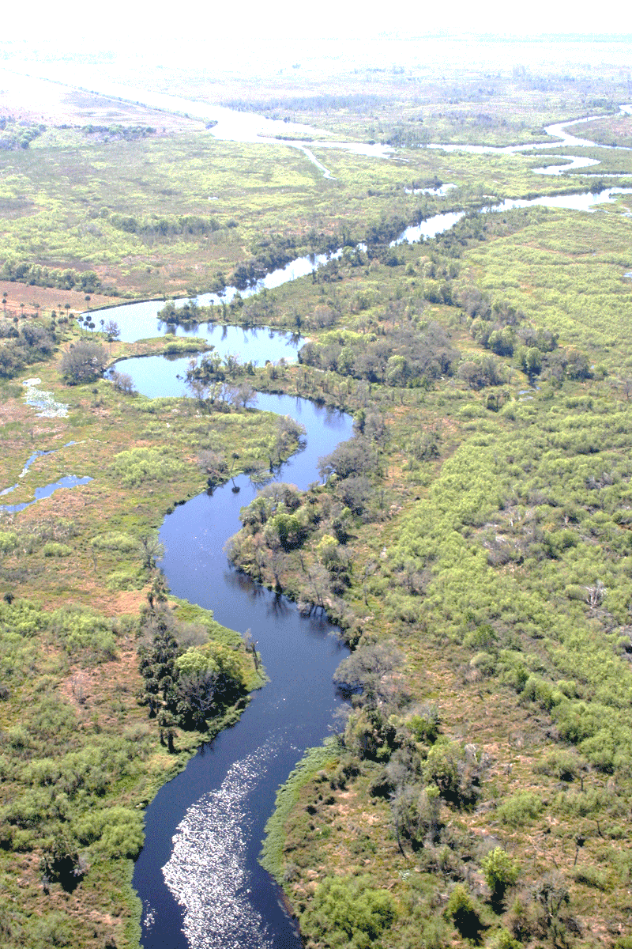
Colorado Basin River Analysis
Colorado Basin Team: Jerry Brooke, Karr Davis, Bruce Jones, Shubh Patel
February 2023
This Photo by Unknown Author is licensed under CC BY-SA-NC

Slide 2
Colorado River Basin (CRB) Analysis
DRAFT
Topic
The final project topic is the Colorado River Basin. The reason the Colorado River was selected is due to the fact that it provides water to a number of states in the Southwest and due the severe droughts in recent years has led to supply and demand challenges. We are interested in how the Rocky Mountain snowpacks and the water levels of Lake Mead and Lake Powell may impact future drought levels.
Data Description:
The data for the CRB analysis will consist of
Water levels for Lake Mead and Lake Powell (https://www.usbr.gov/uc/water/hydrodata/)
Colorado Rockies snowpack (https://www.nrcs.usda.gov/Internet/WCIS/AWS_PLOTS/basinCharts/POR/WTEQ/assocHUCco_8/colorado_headwaters.html)
Geographical Drought data of the Colorado River Basin
Target Question(s):
Do the Rocky Mountain snowpacks have a relationship to future Colorado River Basin levels?
Is there a chance of a severe drought for the Colorado River Basin in the future?

Slide 3
Data Exploration
DRAFT
Data Exploration
The data researched and gathered for the Colorado River Basin project:
Lake Mead and Lake Powell water storage
Rocky Mountain Snowpack
Colorado Headwaters
Colorado Basin Drought data
Drought data by region
Extract Process
The team searched the internet for the Colorado River Basin drought data, Colorado Rocky Mountain snowpack data and Lake Mead and Powell water storage data. For each dataset the data was queried in the respective site
and csv formatted files were extracted. The csv datasets are as follows:
Drought for the Colorado River Basin as percent area
Colorado River headwaters: Rocky Mountain snowpack as snow water equivalent (SWE) in inches
Lake Mead water storage in square feet
Lake Powell water storage in square feet
Other datasets/features we thought of but decided not to include due to assumed overload; “don’t bite off more than we can chew” (population, farming, energy sector, tourism, El Nino/La Nina)

Slide 4
Data Exploration cont.
DRAFT
Transformation Process
We reformatted the four CSV files in order to merge into a single dataset for our Machine Learning model.
Load Process
Created single csv (the merge csv files from above) to be loaded in to ML script
Our method of reading in csv files makes the most sense; in theory moving forward analysts can update the csv files and re-read back in. Building a database would be unnecessary overhead for the size of the dataset.

Slide 5
Data Analysis
DRAFT
Data Analysis:
The Colorado River Basin dataset contained over 250 records, as such we utilized a few techniques to train and evaluate models based on the drought data. In applying the train and test methodology to the dataset, the data Training score is 68% and Testing score is 70%.
In analyzing the data via Supervised ML
Accuracy score: 70%
Drought Severity Low (0): precision: 72%, recall 85%
Drought Severity High (1): precision: 65%, recall 46%
F1 score: 78%

Slide 6
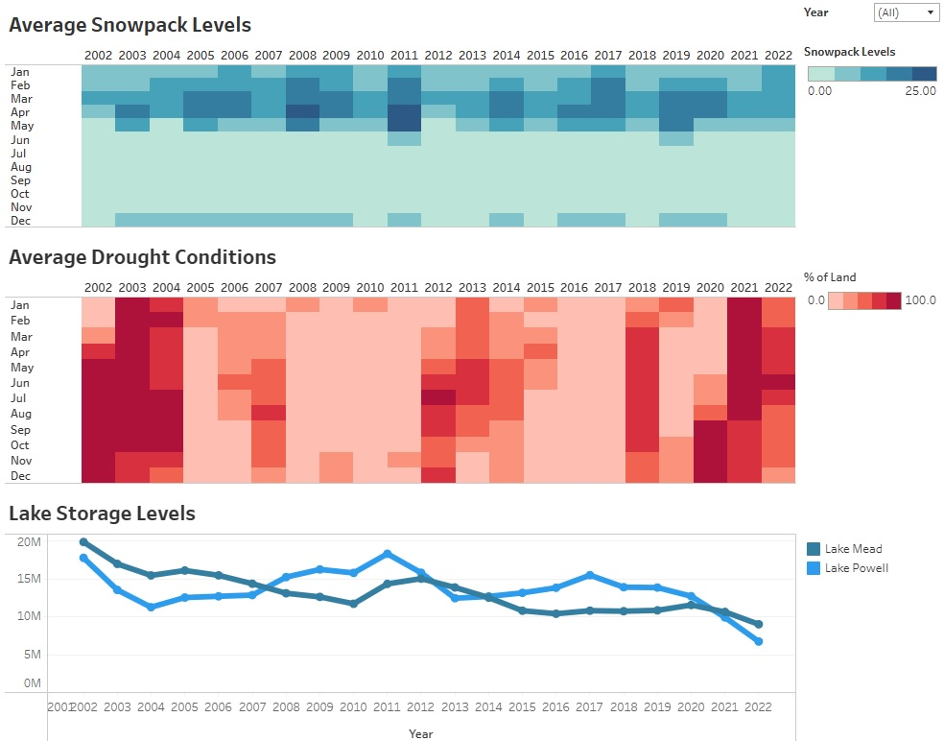
Data Exploration & Analysis
DRAFT
Based on the analysis,
Snowpack levels are high, the Drought conditions are low.
Snowpack levels are low, the Drought conditions are high.
The same holds true as it relates to the Lake Storage levels.
Lake Storage levels are high, the Drought conditions are low.
Lake Storage levels are low, the Drought conditions are high.
Tableau Storybook Analysis Link

Slide 7
Summary
DRAFT
The Colorado River Basin is a complex region with high population growth in many of the metro areas as well as expansive agriculture areas that both depend on and use the river water. There are most likely other features that when added to the dataset could enhance and improve the machine learning component to better predict severe-to-worse-drought for this region. In particular, it would be ideal to find features that could improve the recall (sensitivity) value for predicting severe-to-worse-drought because even when predicted true with an actual false outcome it would trigger the region to conserve water usage as a reaction to the prediction. Having a solid drought prediction model would better prepare the region for water conservation action during periods of drought or non-drought.

Slide 8
Appendix

Slide 9
Technology and Algorithms
DRAFT
The tools and algorithms utilized for the CRB Analysis are as follows:
Jupyter Notebook
Pandas
PostgreSQL
Quick DBD
Tableau
SKLearn

